Slide 1

Future hub
Samir Uddin

Slide 2

11 year olds are worried*
But what are they worried about?
This Photo by Unknown Author is licensed under CC BY-SA

Slide 3


Problem definition:
Young people are worried about securing a job in the future.
Why?
Because they are expected to have skills that they have not been taught or have experienced.
What does this say about employers/job market?
There needs to be a way of bridging the gap between young people and the skills they are looking for.

Slide 4
FUTURE HUB – app for employment skills
Students
Employers
Educational institutions
Access to specific courses to learn skills (E.g Finance management).
Incentivized rewards to students set by school.
Confidence in knowing where to look for resources and guidance
Courses put on, detailing what skills they are looking for, tailored to the business.
Exclusive opportunities for potential employees.
Confidence in higher quality applications and ROI.
Task specific students to courses.
Confidence in students gaining skills for employment after education.
Eases pressure to teach skills by outsourcing to future hub.

Slide 5
Timeline – How wide this solution can be
September 2025
Small cohort of local schools
Small group of local businesses
Small scale rollout - FREE
June 2026
Collect results
Analyse feedback
Improve and make changes
If moderately successful, move on to next stage
September 2026
Wider rollout
Charging schools (POC works)
Get local councils on board
Collab with professional chartered institution (BCS etc)
June 2027
September 2027
Collect further results with more metrics and analyse in detail
Improve and make changes
Collab with bigger businesses
Nationwide deployment
Backed by government
Increased number of employers on app

Slide 6
Feasibility
Canvas
Future Hub
Based on a one-time implementation fee and annual per-user subscription fee.
An average secondary school holds roughly 1,000 students *
Based off the canvas** pricing documentation report, they roughly make from one school:
(1000 students × £10 per head) + £5000 one- time implementation = £15,000 per school
Subsequent £10,000 a year after first year
Following a similar model to canvas
Targeting schools, colleges, 6th forms, universities etc
First year financial projection could be around £3-5k per school
Aimed to be more after subsequent years of proof of concept/work
Can also be backed by government schemes, grants and funding

Slide 7
Scalability
Tech
Social
Government
Employers
Server space
Storage (cloud)
App delivery
Website etc..
Word of mouth
Marketing
School boards
Councils
Promoted via government backed* schemes
Collaboration with Department of Education
More businesses involved = More confidence for other big employers to get involved
Increase in number of youth in workforce

Slide 8
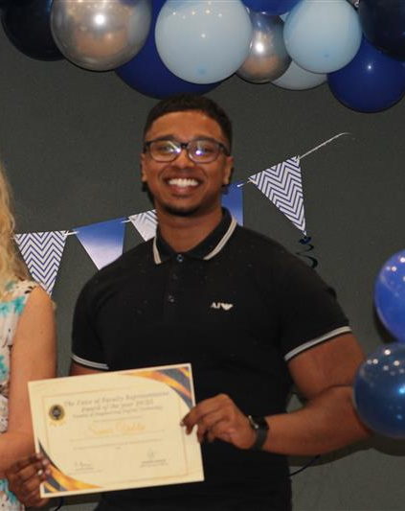
Why me?
The past 3 years (18-21) I have had 5 different jobs with different organisations all in different domains:
Student ambassador (2021 – current)
Mental health support worker (2021-2023)
IT Service Champion (2022-2023)
Software Engineer (2023-2024)
Counsellor (2024 – current)
I would like to say I am somewhat qualified to understand what skills are important to young people and how they can improve their chances to gain employment for the future

Slide 9
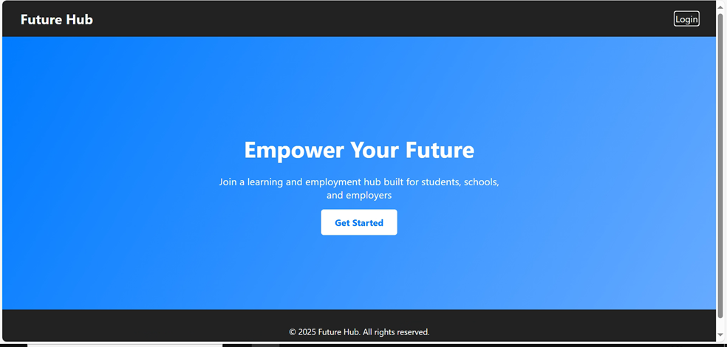
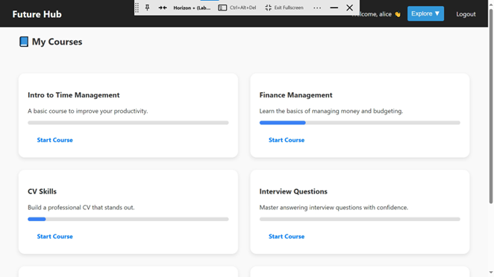
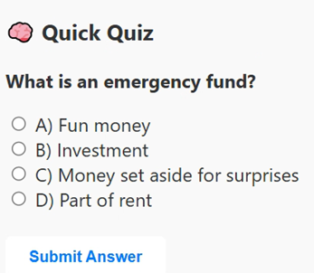
Before I let you go!
Start menu
Student page
Course quiz example
Full repository with instructions can be found here: https://github.com/msuddin2/Future-hub
Please have feel free to have fun and mess around as you wish!

Slide 10


THANK YOU
Samir Uddin
Samir-uddin1@live.co.uk
linkedin.com/in/samir-u-22338224a/

